Slide 1
Paddlegonia
December 9, 2016
Cristopher Aguilar
Stephanie Croker
Michael Schubert
Katrina Shurley
Matthew Vigil
Photo: Fun, Facts N Pics

Slide 2
National Concrete Canoe Competition
Project Purpose
Location and Time
Irvine California
April 6-8th, 2017
Conference Deliverables
Final Design
Racing Placement
Design Paper
Oral Presentation
Figure 1: 2009 Concrete Canoe Competition

Slide 3
Stake Holders
Client: Mark Lamer
Technical Advisor: Taylor Layland
NAU ASCE Chapter
Donors
Civil Engineering, Construction Management and Environmental Engineering (CECMEE) Department
Figure 2: NAU ASCE Chapter Logo

Slide 4
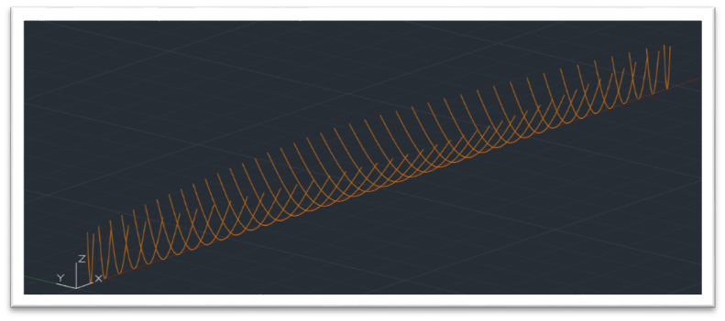
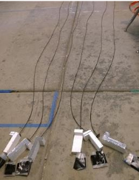
Scope: Analysis & Design
Reinforcement
Mesh
Post-tensioning
Figure 3: AutoCAD Cross Section Design
Structural analysis
Design and calculations
AutoCAD
Evaluation and selection
Figure 4: Canoe Reinforcement

Slide 5
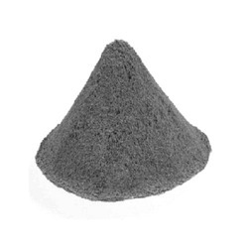
Scope: Concrete Mix Design
Materials Procurement
Cementitious material
Aggregate
Admixtures
Fibers
Main Consideration
25% ASTM C330 compliant material
Figure 5: Grey Portland Cement

Slide 6
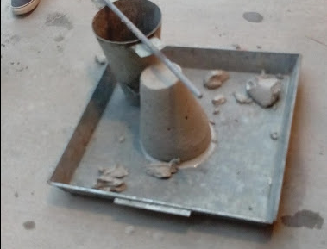
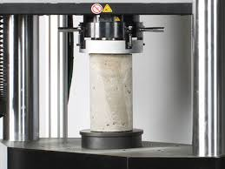
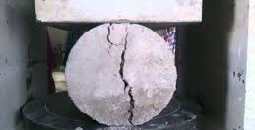
Scope: Testing & Analysis
Concrete Testing
Workability – ASTM C143
Compressive Strength – ASTM C39
Split Tensile Strength – ASTM C496
Figure 6: Slump Test
Figure 8: Split Tensile Test
Figure 7: Compression Test

Slide 7
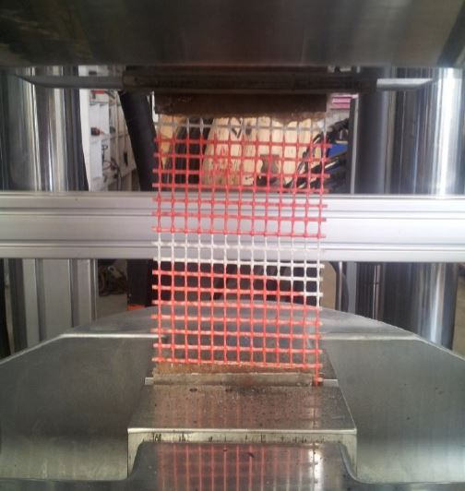
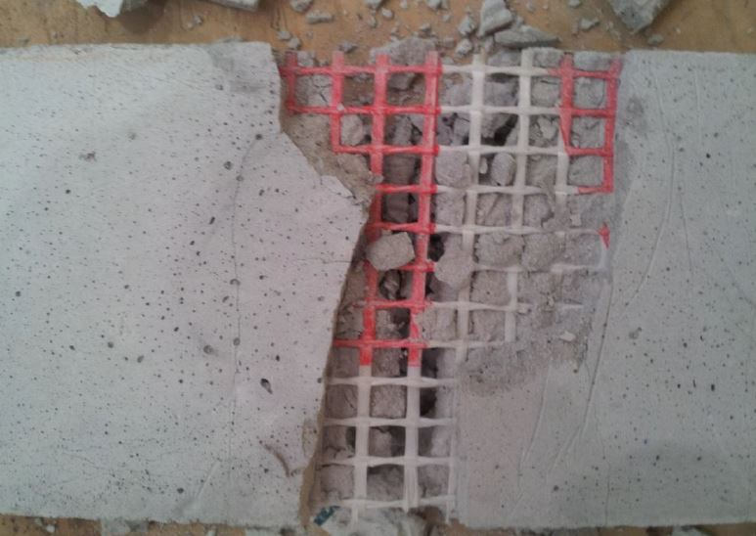
Scope: Testing & Analysis
Reinforcement
Tensile Strength – ASTM E2098
Composite
Flexure Strength – ASTM D7205
Figure 9: Reinforcement Tensile Test
Figure 10: Composite Testing

Slide 8
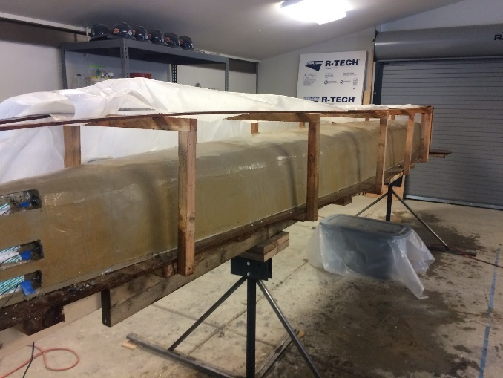
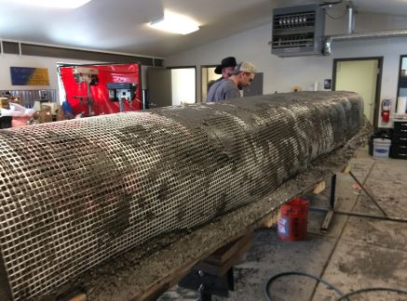
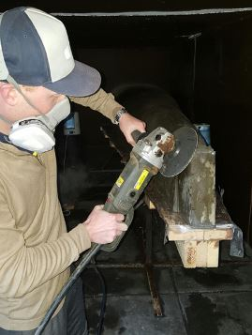
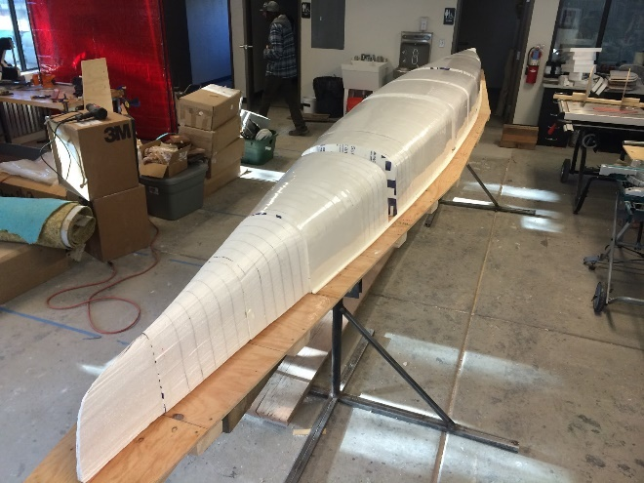
Scope : Construction
Mold Fabrication
CNC male molds
Pour Day & Finishing
Curing chamber
Mold removal
Finishing
Figure 12: Curing Chamber
Figure 11: Reinforcement
Figure 13: Male Mold
Figure 14: Finishing

Slide 9
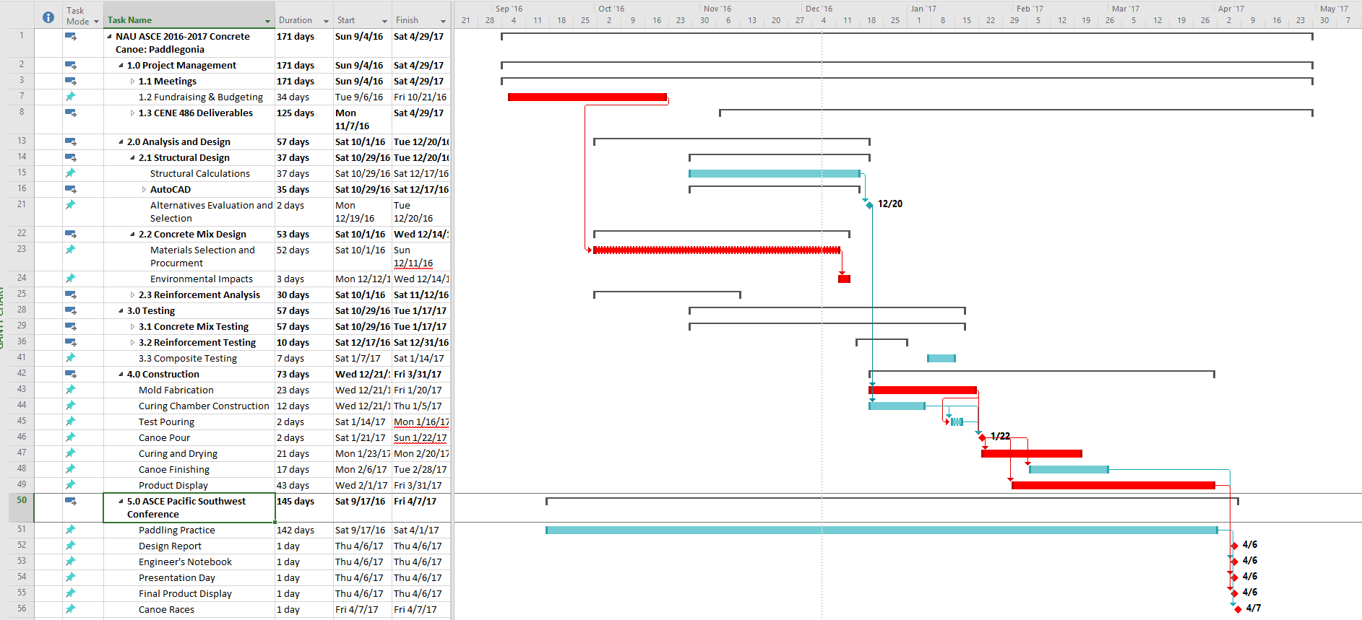

Slide 10
Staffing Matrix
Task | PM | SE | RE | ME | PE | EIT | INT | TE | Subtotal
Fundraising | 15 | 0 | 0 | 0 | 0 | 15 | 15 | 0 | 45
Hull Analysis | 0 | 15 | 0 | 0 | 5 | 10 | 5 | 0 | 35
Structural Analysis | 0 | 45 | 0 | 0 | 0 | 10 | 5 | 0 | 60
Concrete Mix Design | 5 | 0 | 5 | 10 | 5 | 0 | 0 | 1 | 26
Construction Design | 5 | 5 | 10 | 10 | 50 | 20 | 5 | 15 | 120
Concrete Testing | 10 | 10 | 5 | 10 | 10 | 10 | 15 | 50 | 120
Reinforcement Testing | 5 | 0 | 20 | 0 | 0 | 5 | 5 | 20 | 55
Combined Material Test | 5 | 0 | 20 | 20 | 0 | 0 | 0 | 10 | 55
Construction | 50 | 20 | 50 | 50 | 50 | 50 | 100 | 100 | 470
Document | 3 | 2 | 2 | 2 | 2 | 5 | 10 | 1 | 27
Total | 98 | 97 | 112 | 102 | 122 | 125 | 160 | 197 | 1013
Classification | Code
Project Manager | PM
Structural Engineer | SE
Reinforcement Engineer | RE
Materials Engineer | ME
Project Engineer | PE
Engineer in Training | EIT
Intern | INT
Technician | TE

Slide 11
Cost Proposal
1.0 Personnel | Classification | Hours | Rate ($/hr) | Cost
 | PM | 98 | 144 | $14,112.00
 | SE | 97 | 84 | $8,148.00
 | RE | 112 | 80 | $8,960.00
 | ME | 102 | 81 | $8,262.00
 | PE | 122 | 82 | $10,004.00
 | EIT | 125 | 61 | $7,625.00
 | INT | 160 | 23 | $3,680.00
 | TE | 197 | 51 | $10,047.00
 | Total Personnel |  |  | $70,838.00
2.0 Travel | Conference Travel | $0.30/mi | 940 miles | $282
 | Vehicle Rental | $120/day | 4 days | $480
 | Motel | $100/night/room | 3 nights, 2 rooms | $600
3.0 Subcontract | Mold Construction |  |  | $1,000
4.0 Materials |  |  |  | $5,000
5.0 Lab & Equipment Fees |  | 197 hours | $100/hr | $19,700
5.0 Total |  |  |  | $97,900.00

Slide 12
Questions?

